Slide 1
Generalization of a Suffix Tree for RNA Structural Pattern Matching
Tetsuo Shibuya
Algorithmica (2004), vol. 39, pp. 1-19
Created by: Yung-Hsing Peng
Date: Sep. 17, 2004

Slide 2
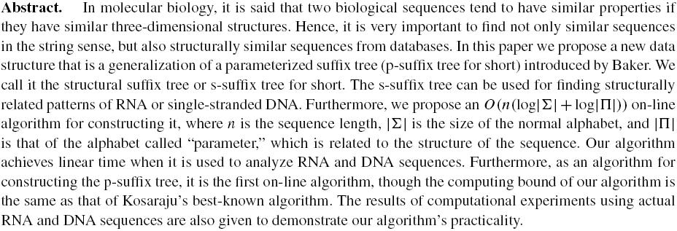

Slide 3
Suffixes
Suffixes for S=“ATCACATCATCA”
ATCACATCATCA | S₍₁₎
TCACATCATCA | S₍₂₎
CACATCATCA | S₍₃₎
ACATCATCA | S₍₄₎
CATCATCA | S₍₅₎
ATCATCA | S₍₆₎
TCATCA | S₍₇₎
CATCA | S₍₈₎
ATCA | S₍₉₎
TCA | S₍₁₀₎
CA | S₍₁₁₎
A | S₍₁₂₎

Slide 4
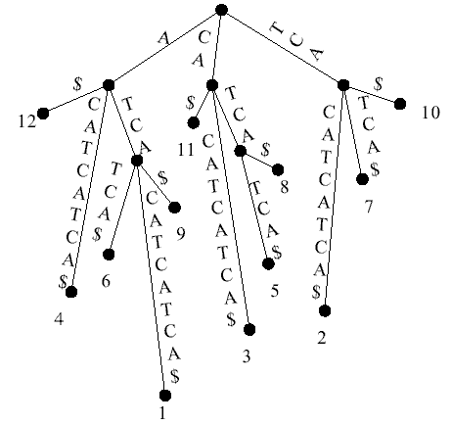
Suffix Trees
A suffix Tree for S=“ATCACATCATCA”

Slide 5
Time Complexity
A suffix tree for a text string T of length n can be constructed in O(n) time (with a complicated algorithm).
To search a pattern P of length m on a suffix tree needs O(m) comparisons.
Exact string matching: O(n+m) time

Slide 6
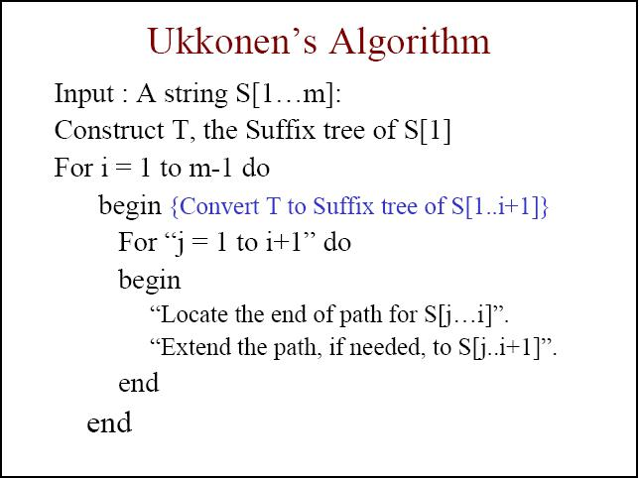

Slide 7
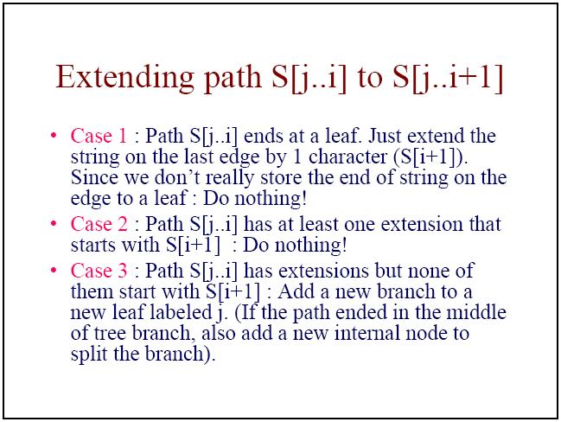

Slide 8
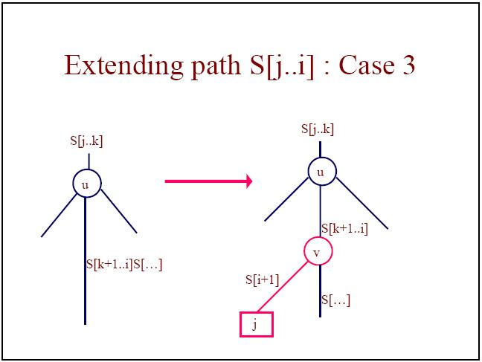

Slide 9
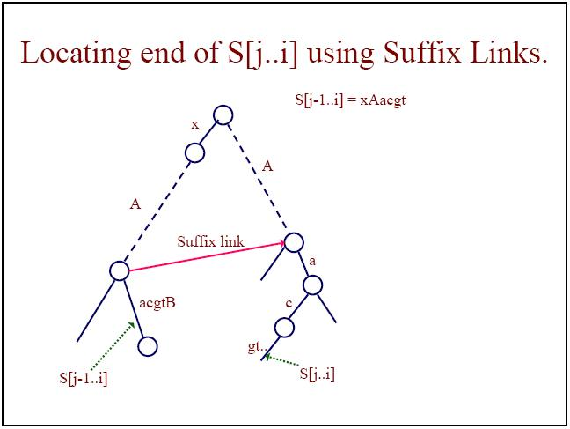

Slide 10
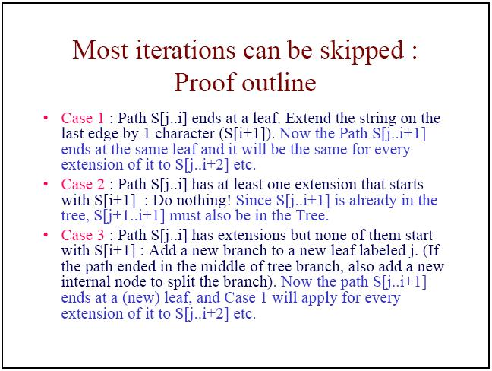

Slide 11
Another matching problem
Suffix tree can help us solve the string matching problem. However, there is another problem called “p-string matching problem”. We need to build p-suffix tree.
Ex: Let Σ={A,B,C} and Π={x,y,z}
ACxBCyzyAzxC and ACyBCzxzAxyC are p- match because both of them can be transfer to AC0BC002A38C by the prev function.

Slide 12
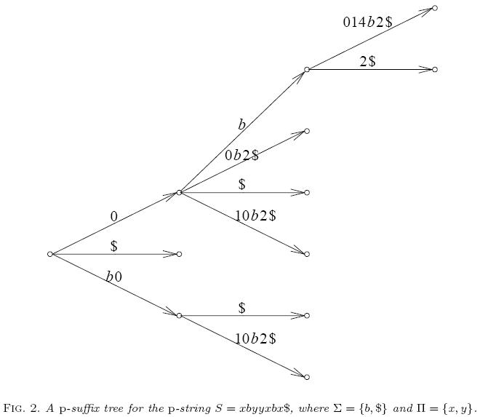

Slide 13
Failure of Ukkonen’s Algorithm on p-suffix
Let Σ={A,B} and Π={x,y,z}
prev(xABx)=0AB3
prev(yABz)=0AB0
prev(ABx)=AB0
prev(ABz)=AB0
and we want to insert x after xABx, then
prev(xABx), prev(ABx), prev(Bx) and prev(x) will
be checked → mis-insert to ABz

Slide 14
Shibuya’s Algorithm
It is the first on-line algorithm which builds p-suffix tree in linear time.
It is based on Ukkonen’s algorithm
Using implicit suffix links, which is implemented by a special data structure called c-queue

Slide 15
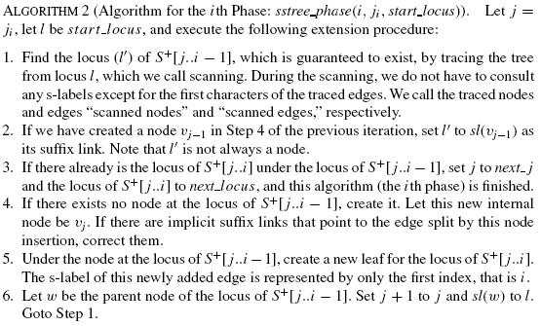
Shibuya’s Algorithm

Slide 16
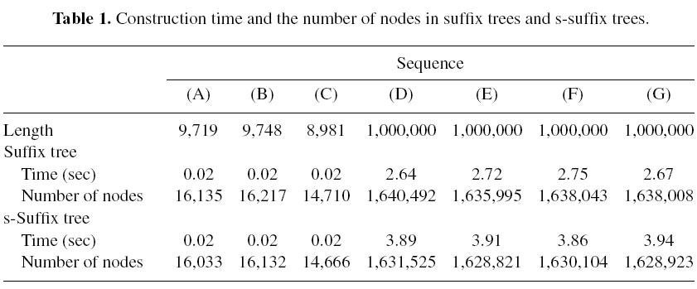

Slide 17
